Slide 1



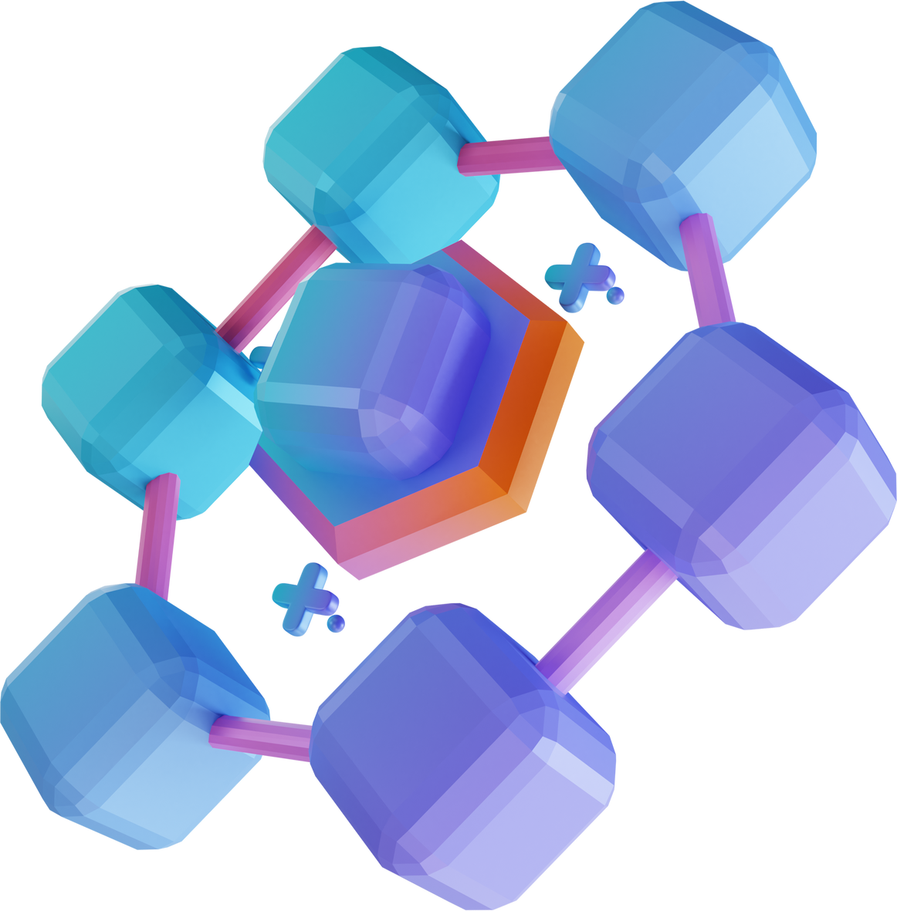
BLOCKCHAIN FUNDAMENTALS
Basics of Blockchain

Slide 2



LIST OF CONTENTS
What is Blockchain 🤷🏾‍♂️?
How do Blockchains Work?
Types of Blockchain
Consensus Mechanisms
Smart Contracts
Tokens 💰
"Why Do We Need Blockchain? 🤔
Decentralized Finance (DeFi) 💸
Uses of Blockchain 🌍🔗

Slide 3



WHAT IS BLOCKCHAIN
Blockchain is a decentralized digital ledger system that securely records information in linked "blocks," forming a transparent and tamper-resistant chain without a single point of control. While best known for powering cryptocurrencies, blockchain's potential extends to various industries, promising to enhance security, increase transparency, and enable innovative processes in fields like supply chain management, voting systems, and healthcare record-keeping.

Slide 4

HOW BLOCKCHAIN WORKS
Blockchain operates by grouping data into interconnected blocks, each containing a unique hash based on its own content and the previous block's hash, forming a tamper-resistant chain of information. This decentralized system relies on a network of computers (nodes) to collectively verify and add new blocks, ensuring data integrity and security without a central authority, making it applicable to various fields beyond just cryptocurrencies.

Slide 5

TYPES OF BLOCKCHAIN
Blockchain systems come in three main types: public blockchains that are open to everyone and prioritize transparency and decentralization (like Bitcoin and Ethereum), private blockchains that restrict access and offer more control for businesses, and hybrid blockchains that combine elements of both to balance openness with privacy. Each type serves different purposes, with public blockchains emphasizing accessibility and decentralization, private blockchains focusing on control and speed, and hybrid blockchains offering a flexible middle ground that can protect sensitive information while still benefiting from decentralized verification.

Slide 6


CONCENSUS MECHANISM
Consensus mechanisms are crucial methods used in blockchain networks to validate transactions and maintain security without central authorities, with Proof of Work (PoW) and Proof of Stake (PoS) being two primary examples. PoW, used by Bitcoin, relies on solving complex puzzles and is energy-intensive, while PoS, a more eco-friendly alternative, selects validators based on the amount of cryptocurrency they hold or "stake," both aiming to keep the blockchain secure and reliable.

Slide 7


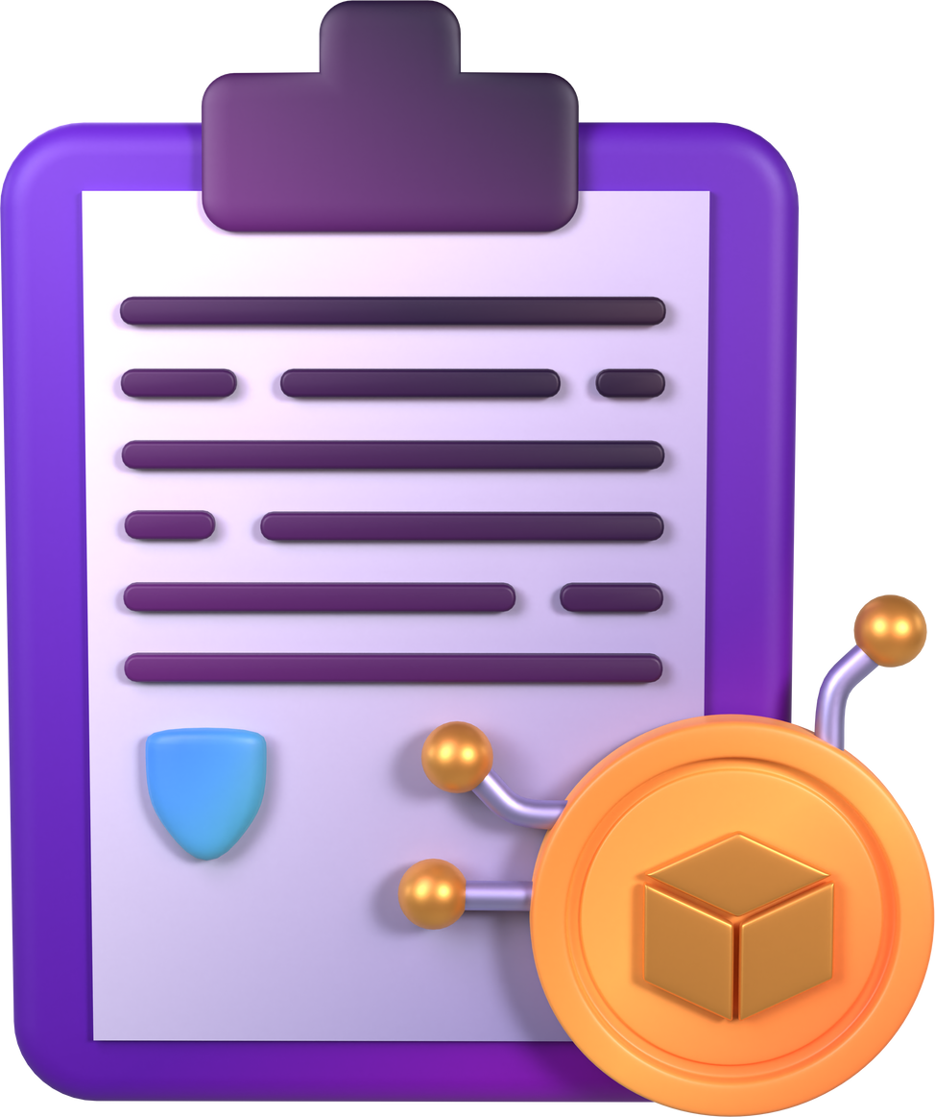
SMART CONTRACTS
Smart contracts are self-executing agreements written in code that automatically execute when predefined conditions are met, operating on blockchain technology to ensure transparency and remove the need for intermediaries. They have wide-ranging applications across various industries, including finance, insurance, and real estate, offering the potential to simplify complex processes and reduce the reliance on middlemen in transactions.

Slide 8
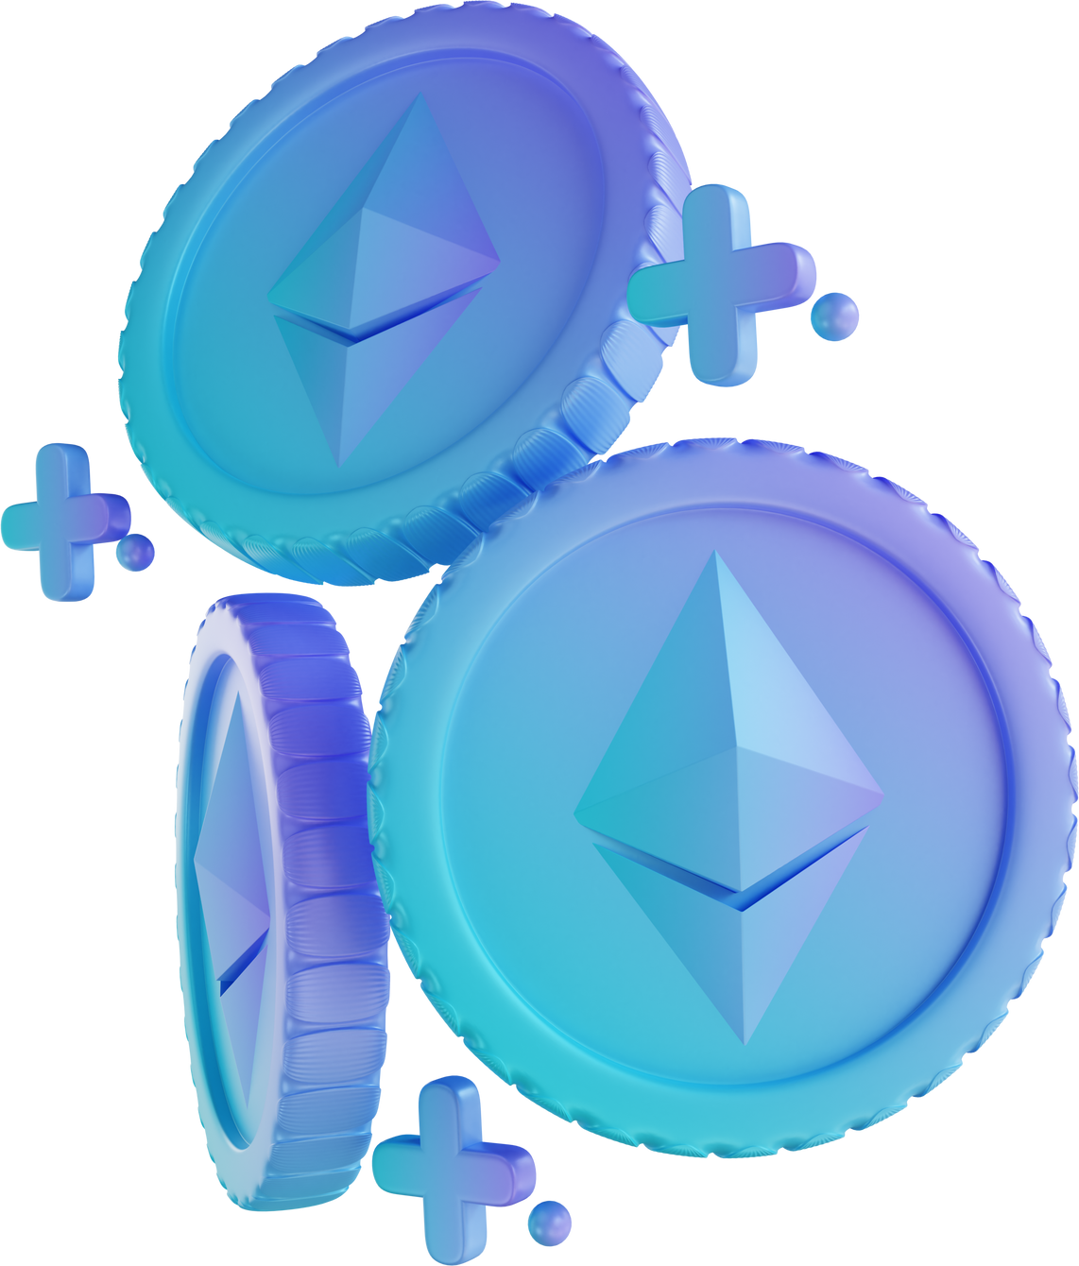
TOKENS
Tokens are digital assets on the blockchain representing various things from money to property, used for transactions, voting, or as collectibles like NFTs. The lesson covers three main types: utility tokens for accessing products or services, security tokens tied to investments, and NFTs representing unique digital items, all of which enable new ways to interact with digital assets securely.

Slide 9


WHY DO WE NEED BLOCKCHAIN?
Tokens are digital assets on the blockchain that can represent various things like money or property. The lesson covers different types of tokens, including utility tokens (for accessing products or services), security tokens (investment-like assets), and NFTs (unique digital items). It emphasizes how tokens enable new ways of interacting with digital assets securely in various applications.

Slide 10
DECENTRALIZED FINANCE
DeFi is a blockchain-based financial system that operates without traditional banks, allowing direct borrowing, lending, and trading. Key points include:
Definition: DeFi enables financial transactions without intermediaries.
Earning opportunities: Users can earn through liquidity pools by providing cryptocurrency for others to borrow.
Popular platforms: Examples include Uniswap for trading and Aave for lending.
Accessibility: DeFi services are available to anyone with a crypto wallet and internet connection.
Impact: DeFi is revolutionizing finance by making it more transparent, accessible, and inclusive globally.

Slide 11
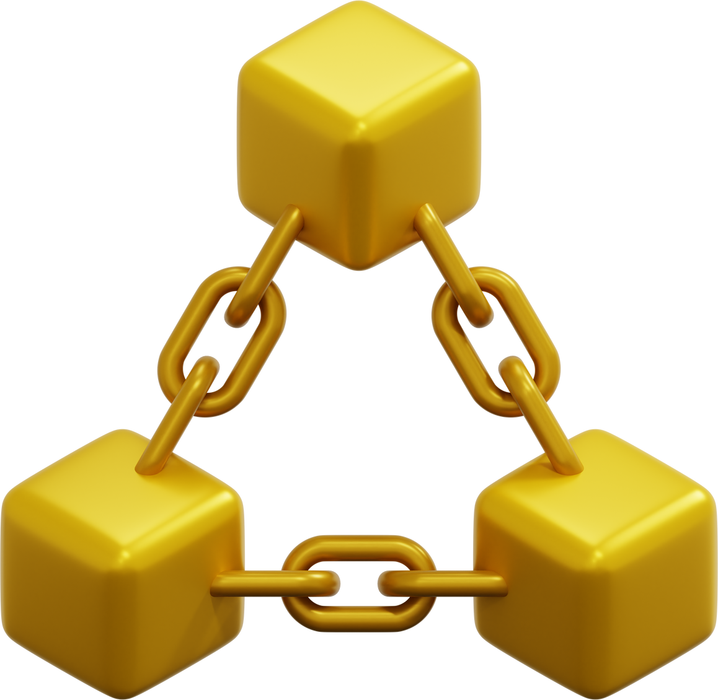
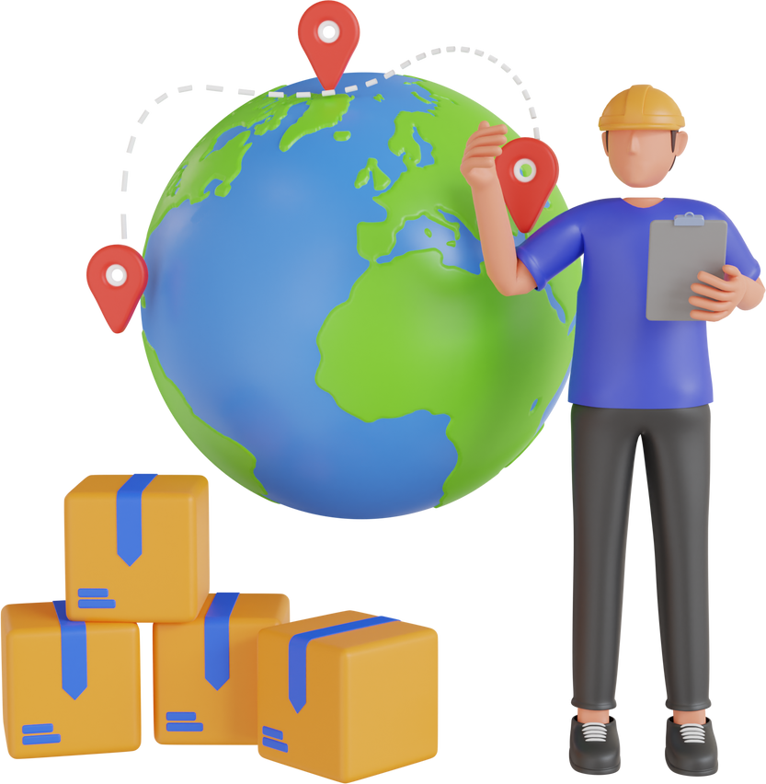
USES OF BLOCKCHAIN
Supply Chain: Track products from source to consumer
Healthcare: Secure and accessible patient records
Voting: Tamper-proof election processes
Blockchain's transparency and security extend beyond these applications, with potential for wider adoption across industries.

Slide 12


